Slide 1

Computer Architecture
Course Code: CSE360
Lecture 14
Reduced Instruction Set Computers

Slide 2
The Next Step - RISC
Reduced Instruction Set Computer (RISC)
Key features
  Large number of general purpose registers
  or use of compiler technology to optimize register use
  Limited and simple instruction set
  Emphasis on optimising the instruction pipeline

Slide 3
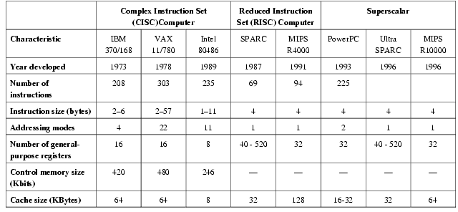
Comparison of processors

Slide 4
Driving force for CISC
Software costs far exceed hardware costs
Increasingly complex high level languages
Semantic gap (the difference between operations provided in HLLs and those provided in computer architecture)
Leads to:
  Large instruction sets
  More addressing modes
  Hardware implementations of HLL (high-level languages) statements

Slide 5
Intention of CISC
Ease the task of compiler writing
Improve execution efficiency
  Complex sequences of operations can be implemented in microcode
Provide support for more complex HLLs

Slide 6
Compiler-Based Register Optimization
Optimized register usage is the responsibility of the compiler
The objective of the compiler is to keep the operands for as many computations as possible in registers rather than main memory and to minimize load-store operations
The optimization task is to decide which quantities are to be assigned to register at any given point in the program; the technique used commonly in RISC compilers is known as graph coloring

Slide 7
Graph Coloring
Given a graph of nodes and edges
Assign a color to each node
Adjacent nodes have different colors
Use minimum number of colors
Nodes are symbolic registers
Two symbolic registers that are live in the same program fragment are joined by an edge
Try to color the graph with n colors, where n is the number of real registers
Nodes that can not be colored are placed in memory

Slide 8
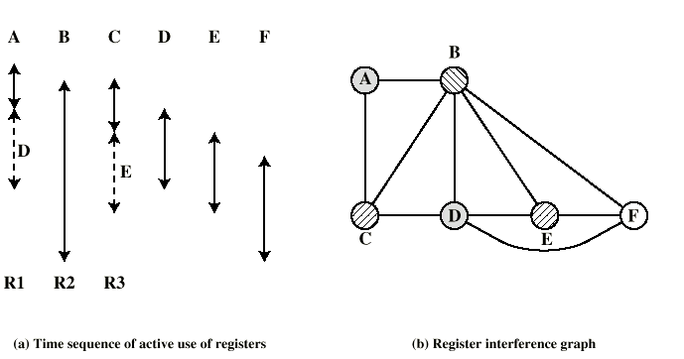
Graph Coloring Approach
Assume a program with six symbolic registers to be compiled into three actual registers
Nodes that share the same color can be assigned to the same register
A possible coloring with three colors is indicated
One symbolic register F is left uncolored and are placed in memory

Slide 9
RISC Characteristics
One instruction per cycle
Register to register operations
Few, simple addressing modes
Few, simple instruction formats
Hardwired design (no microcode)
Fixed instruction format
More compile time/effort

Slide 10
RISC v CISC
Not clear cut
Many designs borrow from both philosophies
e.g. PowerPC and Pentium II

Slide 11
RISC Pipelining
Most instructions are register to register
Two phases of execution
  I: Instruction fetch
  E: Execute
    ALU operation with register input and output
For load and store
  I: Instruction fetch
  E: Execute
    Calculate memory address
  D: Memory
    Register to memory or memory to register operation

Slide 12
RISC Pipelining
(a) depicts the timing of a sequence of instructions using no pipelining. Clearly this is s wasteful approach. Even very simple pipelining can improve the performance
(b) shows two stage pipelining scheme, in which I and E stages of two different instructions are performed simultaneously. This scheme can yield up to twice the execution rate of a sequential scheme.
(c) shows three instructions can be overlapped and improvement is as much as a factor of 3. The pipelining works best if three stages are of equal duration
(d) shows the result with a four stage (E1→ Register file read and E2→ ALU operation and register write)
→NOOP (No operation) to account for data and branch delays.

Slide 13
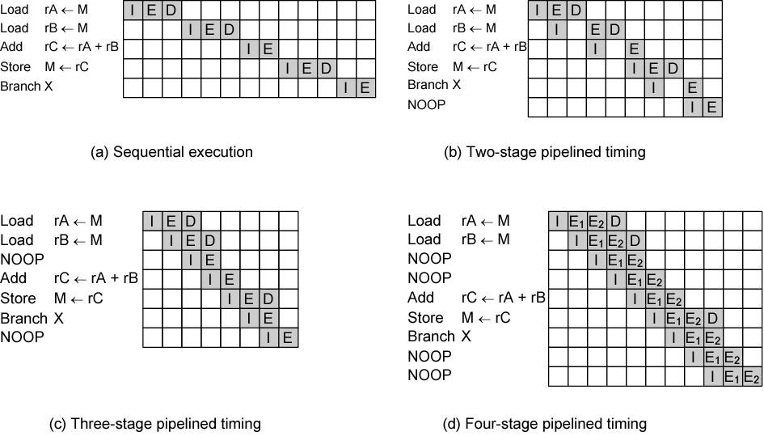
Effects of Pipelining

Slide 14
Superscalar Processors

Slide 15
What is Superscalar?
A superscalar processor is one in which multiple independent instruction pipelines are used.
Each pipeline consists of multiple stages, so that each pipeline can handle multiple instructions at time.
Multiple pipelines introduce a new level of parallelism, enabling multiple instructions to be processed at a time
Common instructions (arithmetic, load/store, conditional branch) can be initiated and executed independently
Equally applicable to RISC & CISC
In practice usually RISC

Slide 16
Why Superscalar?
The term superscalar refers to a machine that is designed to improve the performance of the execution of scalar instruction
Most operations are on scalar quantities (see RISC notes)

Slide 17
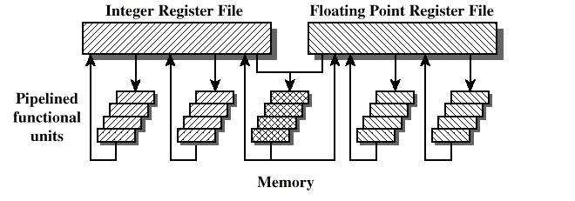
General Superscalar Organization
Figure shows superscalar organization
There are multiple functional units, each of which is implemented as a pipeline, which support parallel execution of several instructions
e.g. two integer, two floating point, and one memory (either load or store) operations can be executing at the same time

Slide 18
Superpipelined
Superpipelining exploits the fact that many pipeline stages performs tasks that require less than half a clock cycle
Thus, double internal clock speed gets two tasks per external clock cycle

Slide 19
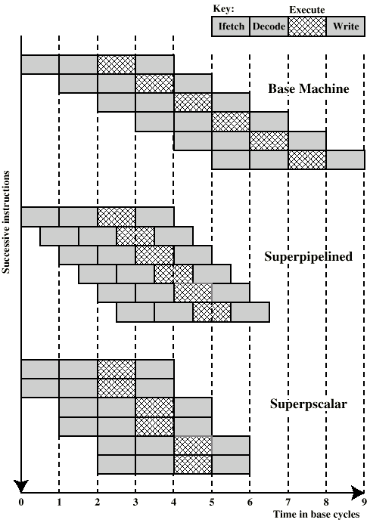
Superscalar v
Superpipeline
The pipeline has four stages: instruction fetch, operation decode, operation execution, and result wire back
In 4-stage pipeline, several instructions are executing concurrently, only one instruction is in its execution state at any one time
Superpipelined implementation capable of performing two pipeline stages per clock cycle (the function performed in each stage can be split into two non-overlapping parts and each can execute in half a clock cycle)
Superscalar implementation capable of executing two instances of each stage in parallel.
The superlined processor falls behind the superscalar processor

Slide 20
Parallel Processing

Slide 21
Multiple Processor Organization
Single instruction, single data stream - SISD
Single instruction, multiple data stream - SIMD
Multiple instruction, single data stream - MISD
Multiple instruction, multiple data stream- MIMD

Slide 22
Single Instruction, Single Data Stream - SISD
A single processor
Executes single instruction stream
Operate data stored in single memory
Uni-processor falls into this category

Slide 23
Single Instruction, Multiple Data Stream - SIMD
Single machine instruction
Controls simultaneous execution
Number of processing elements
Lockstep basis
Each processing element has associated data memory
Each instruction executed on different set of data by different processors
Vector and array processors

Slide 24
Multiple Instruction, Single Data Stream - MISD
Sequence of data
Transmitted to set of processors
Each processor executes different instruction sequence
Never been implemented

Slide 25
Multiple Instruction, Multiple Data Stream- MIMD
Set of processors
Simultaneously execute different instruction sequences
Different sets of data
SMPs (symmetric multiprocessors), clusters, and NUMA (non-uniform memory access) systems
MIMD can be subdivided by means in which the processors communicate

Slide 26
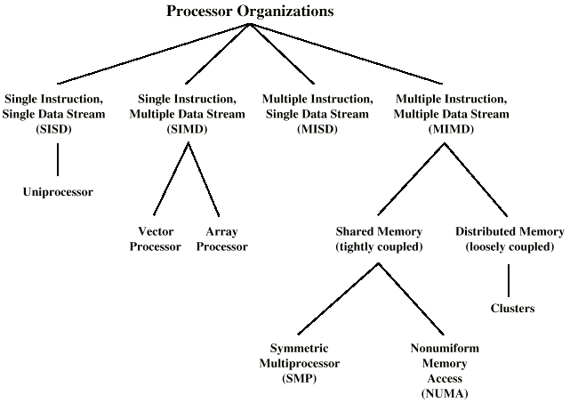
Taxonomy of Parallel Processor Architectures

Slide 27
MIMD - Overview
General purpose processors
Each can process all instructions necessary
MIMD can be subdivided by means in which the processors communicate

Slide 28
Tightly Coupled - SMP
Processors share memory
Communicate via that shared memory
Symmetric Multiprocessor (SMP)
  Share single memory or pool
  Shared bus to access memory
  Memory access time to given area of memory is approximately the same for each processor

Slide 29
Tightly Coupled - NUMA
Nonuniform memory access
Access times to different regions of memroy may differ

Slide 30
Loosely Coupled - Clusters
Collection of independent uniprocessors or SMPs
Interconnected to form a cluster
Communication via fixed path or network connections

Slide 31
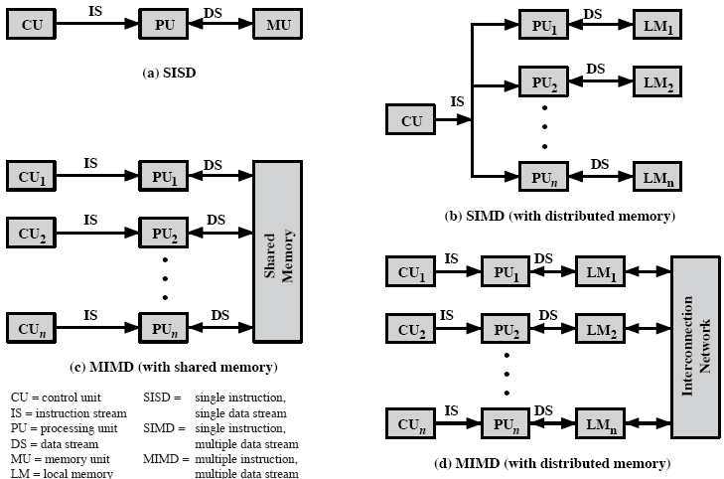
Parallel Organizations
(b) With an SIMD, there is still a single control unit, feeding a single instruction unit to multiple PUs (for multiple data)
(b) Each PU may have its own dedicated memory or there may be a shared memory
Finally, with the MIMD, there are multiple control units, each feeding a separate instruction stream to its own PU
The MIMD may be shared-memory multiprocessor (c) or a distributed-memory multicomputer (d)

Slide 32
Symmetric Multiprocessors
A stand alone computer with the following characteristics
  Two or more similar processors of comparable capacity
  Processors share same memory and I/O
  Processors are connected by a bus or other internal connection
  Memory access time is approximately the same for each processor
  All processors share access to I/O
    Either through same channels or different channels giving paths to same devices
  All processors can perform the same functions (hence symmetric)
  System controlled by integrated operating system
    providing interaction between processors
    Interaction at job, task, file and data element levels

Slide 33
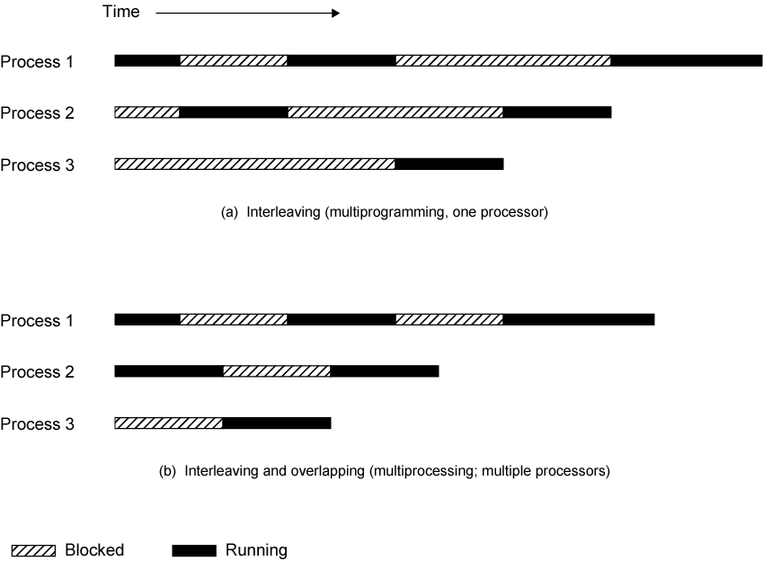
Multiprogramming and Multiprocessing

Slide 34
SMP Advantages
Performance
  If some work can be done in parallel, then a system with multiple processors yield greater performance than one with a single processor of the same type (see figure)
Availability
  Since all processors can perform the same functions, failure of a single processor does not halt the system
Incremental growth
  User can enhance performance by adding additional processors
Scaling
  Vendors can offer range of products based on number of processors

Slide 35
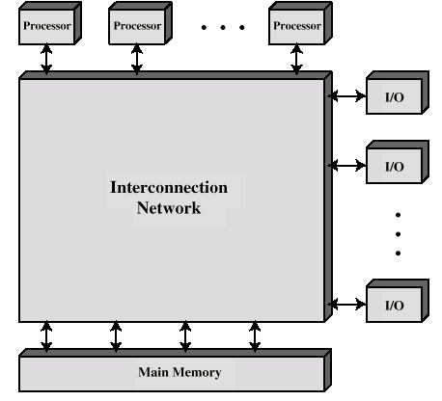
Block Diagram of Tightly Coupled Multiprocessor
There are two or more processors
Each processor is self-contained, including a control unit, ALU, registers, and one or more level of cache
Each processor has access to a shared main memory and I/O devices through interconnection mechanism
The processors can communicate with each other through memory

Slide 36
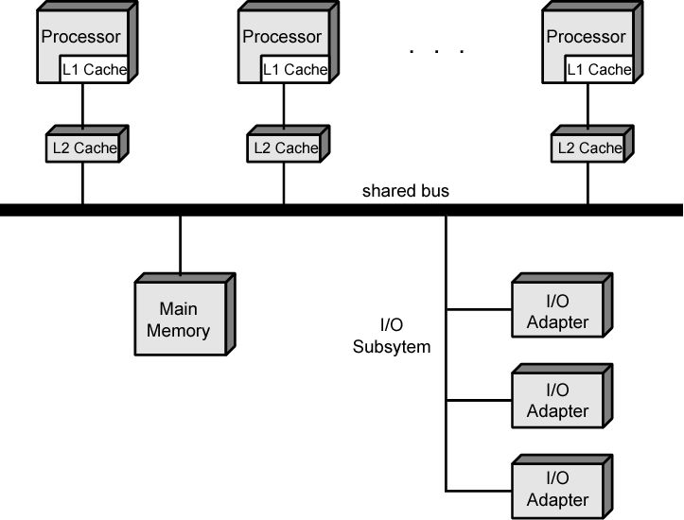
Symmetric Multiprocessor Organization
The time shared bus is the simplest mechanism for constructing a multiprocessor system
The structure and interfaces are basically the same as for a single processor system that uses a bus interconnection
The bus consists of control, address, data lines

Slide 37
Multithreading and Chip Multiprocessors
Instruction stream divided into smaller streams (threads)
Executed in parallel
Wide variety of multithreading designs
The most important measure of performance for a processor is the rate at which it executes instruction. This can be expressed as,
MIPS rate = f × IPC
where f is the processor clock frequency in MHz, and IPC (instructions per cycle).

